Slide 2
Getting to Know
ImageRight Enterprise Scanner

Slide 3
Class objectives
Architecture (N-Tier)
ImageRight Enterprise Scanner
ImageRight Enterprise Processor
Enterprise Gateway (IR Server)
Document Preparation
Types of Scanning (Folder, Flow, Indexing)
Install Scanner
Interface Options
Notes:
I will be referring to the Enterprise Gateway as the IR Server. Know that they are one in the same. Gateway is the concept, server does the work.

Slide 4
Architecture
N-Tier
An N-Tier application is one that is distributed among three or more separate computers in a distributed network. The most common form of N-Tier is the 3-Tier application in which user interface programming is in the users computer, business logic is in a more centralized computer, and needed data is in a computer that manages a database.
Notes:
* One of the reasons we chose N-Tier architecture is it allows us the ability to scan at remote sites.

Slide 5
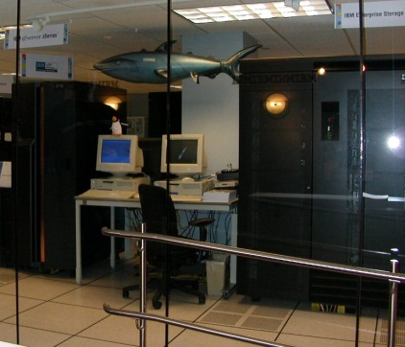
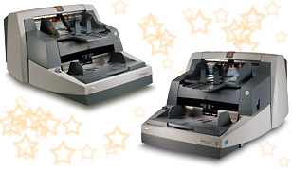
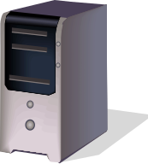
Architecture
3-tier N-Tier Architecture
Presentation Tier
- ImageRight Enterprise Scanner
- ImageRight Enterprise Processor
Business Logic Tier
- IR Server
3. Server Tier
- Database and Images
Presentation
Business Logic
Server Tier
IR Server contains all of the business logic required to access the ImageRight system
Scanner/Processor PC’s
Database and Images

Slide 6
What is the ImageRight Enterprise Scanner?
The ImageRight Enterprise Scanner captures documents as images, saves the images, and makes them available for further processing and retrieval. It is designed to provide both main and remote sites with an integrated scanning solution. You may run the application at your main site on multiple scanners as well as in remote offices. The ImageRight Enterprise scanner enables the transfer of images from remote scanning locations to a main storage (Images) directory.
Notes:
Essentially the Scanner will take this paper, capture it as an image, save the image, and make it available for further processing and retrieval in the IR system.

Slide 7
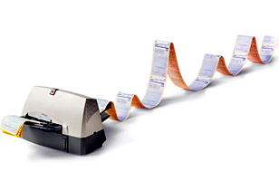
ImageRight Enterprise Scanner
IR Scanner comprised of Four Modules
ImageRight Enterprise Scanner
- User Interface
Enterprise Processor
- User Interface, but also does Business logic and sends data Enterprise Gateway
Enterprise Gateway
- IRServer.dll Manages the updates to the database and moves images to the Images directory
4. Database and Images.
IR Server
Scanner
Processor
File Server

Slide 8
ImageRight Enterprise Scanner
Cache Directory
- C:\IRCache
- Location where images are stored temporarily after being scanned, and before IR Enterprise Processor moves them to the default storage device.
XML (Extensible Markup Language)
- Stored in Cache
- Read by Processor
- Contains information about the batch such as the batch number, date captured, number of documents and pages
- Contains information about each page like document assignment, Drawer, File Number and if task is created

Slide 9
What is the ImageRight Enterprise Processor?
The Enterprise Processor makes it possible for you to queue scanned batches to be processed. This is particularly important for those organizations with remote locations or multiple scanners in a single location. While you continue scanning batch after batch, the Enterprise Processor, will remove images from the cache and pass them on to Active Document Storage.
Notes:
A good example of how this works is a Print Queue. Lets pretend everyone in this room is going to print out this powerpoint presentation. We all hit print and it will end up in the print queue according to It will process each request as it comes in until the queue is empty. This is kind of like how the Processor works however in the Processor you can prioritize.

Slide 10
ImageRight Enterprise Processor
Processor priority
1. Flagged batches
2. Scheduled batches (if it is the scheduled time)
3. Regular batches
How a batch is processed
1. Enterprise Processor logs into the database as the user who scanned the batch.
2. The *.xml file is read, and the image data is loaded into the batch object (memory)
3. Processor loops through the batch object and sends the image data to the IR Server
4. IR Server processes the batch and confirms success

Slide 11
ImageRight Enterprise Processor
If batch processed successfully
- Clears the cached images
- Deletes the directory
- Deletes the *.xml file
- Updates the status to Processed
- Moves the status *.xml into the Processed folder in the current date subfolder
- Moves to the next batch

Slide 12
Enterprise Gateway
Local Install
Enterprise Scanner
Database
IRCache
Gateway (irserver.dll)
Enterprise Processor
Images
Remote Install
Enterprise Scanner
Database
IRCache
Gateway (irserver.dll)
Enterprise Processor
Images
Notes:
Ask some questions
Before we get into the scanner application interface you need to have a good understanding of the Concept of scanning. It’s a simple concept.
What type of architecture is the scanner based on? N-tier
How many tiers does the scanner consist? 3
What are those tiers? Presentation, Server, Database/Images
What does the Enterprise Scanner do? Converts the paper to images.
Images are part of an .xml. Where does it put the .xml? IRCache
What does the Processor do? Takes .xml from IRCache and sends them to IRServer

Slide 13
Document Preparation
Staples and Paperclips
Legal or Letter size
Separator pages (blank sheet or barcode)
Color patch
Count the number of Documents
Batch header sheet

Slide 14
Scanning Methods
Scan to Folder (Backscanning)
- This allows the Scanner Operator to enter the File Number related to documents and have them stored immediately rather that processed through a workflow
Scan to Workflow
- This allows the Scanner Operator to choose a specific Workflow in the system. Scanning to a workflow will create a temporary file for each document scanned, and a task will be created on the first page of every document.
- Indexing Step – Typically first step in a workflow. Primary function is to associate Documents with Files.
Notes:
Indexing Step example: Client scans in new mail for the day. When scanning in the new mail they will select a flow to scan into. Usually the first step in that flow will be the index step. Each document scanned in will be assigned a temporary File Number and the task associated with this document will go to the first step in flow or index step. There is usually someone who is assigned to work this step and what they will do in the indexing step is assign each of these documents to the appropriate File Number/Name and release the task.

